Slide 1
Transformation oriented programming

Slide 2
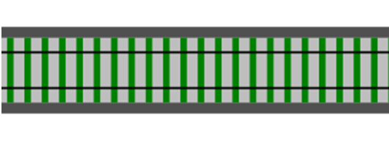
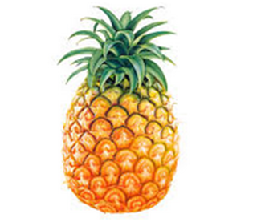
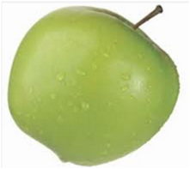
Transformation oriented programming
Function input type -> output type
Input
Output
input
output
Function pineapple -> apple
a transformation

Slide 3
Transformation oriented programming
let add1 x = x + 1
let double x = x * 2
let square x = x * x
input
output
val add1 : int -> int
val double : int -> int
val square : int -> int
"add1" is a transformation

Slide 4
Pipes

Slide 5
Pipes
Standard way of nesting function calls – can lose focus on what is going on
add1 5 // = 6
double (add1 5) // = 12
square (double (add1 5)) // = 144
pipe
5 |> add1 // = 6
5 |> add1 |> double // = 12
5 |> add1 |> double |> square // = 144
pipe
5
|> add1
|> double
|> square // = 144
Splitting onto new lines is more readable for long chains

Slide 6
Piping practice

Slide 7
Composition as a design principle

Slide 8
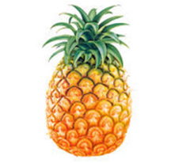
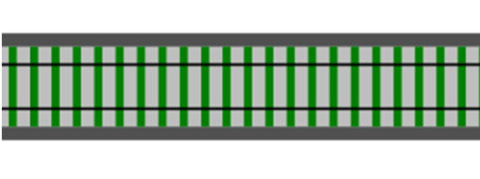

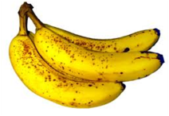
Composition as a design principle
How can we build functionality from smaller pieces?
Function 1 pineapple -> apple
Function 2 apple -> banana

Slide 9
Composition as a design principle
Function 1 pineapple -> apple
>>
Function 2 apple -> banana
Composition

Slide 10
Composition as a design principle
New function
New Function 3 pineapple -> banana
Can't tell it was built from smaller functions!

Slide 11
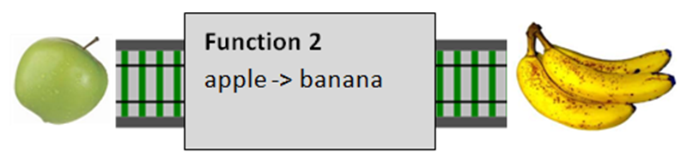
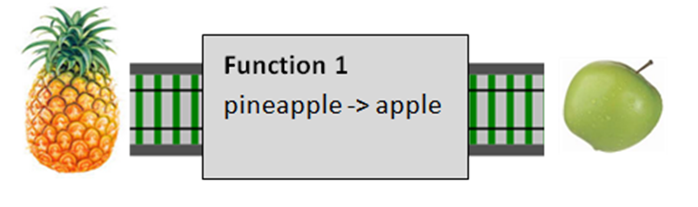
Composition as a design principle
Composition is type checked!
X
>>
☹

Slide 12
Functions are interfaces
Logging example
The “decorator” pattern

Slide 13
Partial Application

Slide 14
Partial application
The parameters to functions are separated by whitespace. Why?
let name = "Dennis"
printfn "Hello, my name is %s" name
Why not use parentheses around the parameters like "normal" languages do?
let name = "Dennis"
printfn("Hello, my name is %s",name)
Because, amazingly, in a functional language you can put the parentheses in a completely unexpected place, around the first two parts.
let name = "Dennis"
(printfn "Hello, my name is %s") name
If you have a function with more than one parameter, you can take just the first bit and make it into a new standalone function! The new standalone function now has the first parameter "baked in".
let hello = (printfn "Hello, my name is %s")
hello "Dennis" // "Hello, my name is Dennis"

Slide 15
Partial application
Partial application is an incredibly simple yet powerful idea. Understanding this is one of the keys to "thinking functionally".
Partial application can be used anywhere you want to bake in parameters.
let add x y = x + y
You can now define "add2" in terms of this, rather than defining a new function. In this case we want to bake in a "2" as one of the parameters.
let add2 x = add 2 x
let add2 x = (add 2) x
let add2 = add 2 // only one parameter supplied to add!
Here is "double" defined in terms of a more generic "multiply" function.
let multiply x y = x * y
let double = multiply 2

Slide 16
Partial application
It is very common to use partial application in conjunction with the piping style
Rather than defining intermediate functions "add2" and "double":
5
|> add2
|> double // = 14
we can just write:
5
|> add 2
|> multiply 2 // = 14
And of course we can extend this to more complex list transformations too:
[1..10]
|> List.map (add 1)
|> List.map (multiply 2)

Slide 17
Partial application
Let's use this approach to print a list of names.
We start by defining a new function called "hello", as we did earlier.
let hello = printfn "Hello, my name is %s"
We can just then just iterate through the list
["Alice"; "Bob"; "Carol"]
|> List.iter hello
Or if we're lazy, we can skip that step and use the "printfn" function inline, with partial application to bake-in the format string.
["Alice"; "Bob"; "Carol"]
|> List.iter (printfn "Hello, my name is %s" )

Slide 18
Partial Application practice

Slide 19
Wrapping BCL functions for partial application
let replace oldStr newStr (s:string) =
s.Replace(oldValue=oldStr, newValue=newStr)
let startsWith lookFor (s:string) =
s.StartsWith(lookFor)
let result =
"hello"
|> replace "h" "j"
|> startsWith "j"
["the"; "quick"; "brown"; "fox"]
|> List.filter (startsWith "f")

Slide 20
Designing functions for partial application
Put earlier: parameters more likely to be static
Put last: the data structure or collection (or most varying argument)
For well-known operations such as “subtract”, put in the expected order

Slide 21
Partial application practice #2
Write wrappers for System.String replace, startsWith, contains, split, trim
Use partial application to filter and map lists of strings
Find the longest string that contains both “h” and “e”
Split a string into words and find the most frequent word

Slide 22
Partial application for dependency injection
Say that we want to fetch a customer from a data store.
type GetCustomer = CustomerId -> Customer
But where’s the database?
How can this function work without a database to talk to?
let getCustomerFromDatabase connection customerId = // from connection // select customer // where customerId = customerId
But we can now do a trick!
We can pass in only the first parameter (the connection), and get back a new function which now just takes the customerId, exactly as we want.
let getCustomer = getCustomerFromDatabase myConnection
// getCustomer : CustomerId -> Customer

Slide 23
Partial application for dependency injection
We can easily mock a different version of the same function for testing
let getCustomerFromMemory map customerId = map |> Map.find customerId
let getCustomer = getCustomerFromMemory myMap
// getCustomer : CustomerId -> Customer
So now we have two versions of a “getCustomer” function.
One was created by partially applying the database connection, and one was created by partially applying the map.
They both have the same signature and are completely interchangeable, and they have both been “injected” with a different dependency.

